Slide 1
120 Years of the Olympic Games
EE0005 AY2019/2020 Semester 2

Slide 2


Dataset used: https://www.kaggle.com/heesoo37/120-years-of-olympic-history-athletes-and-results
120 Years of Olympic Games
Notes:
https://en.wikipedia.org/wiki/Olympic_Games#/media/File:Olympic_rings_without_rims.svg(Image refrence)
https://upload.wikimedia.org/wikipedia/commons/7/7c/Kaggle_logo.png(Image refrence)

Slide 3
Content Page
Problem Definition
Exploratory Data Analysis
Preparing the dataset
Machine Learning models
Conclusion

Slide 4
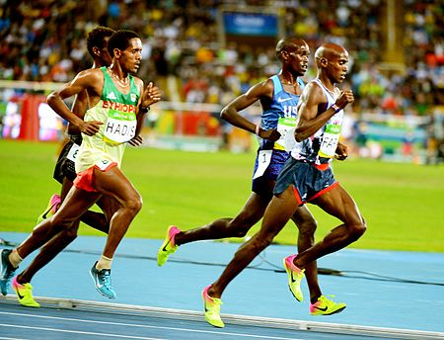
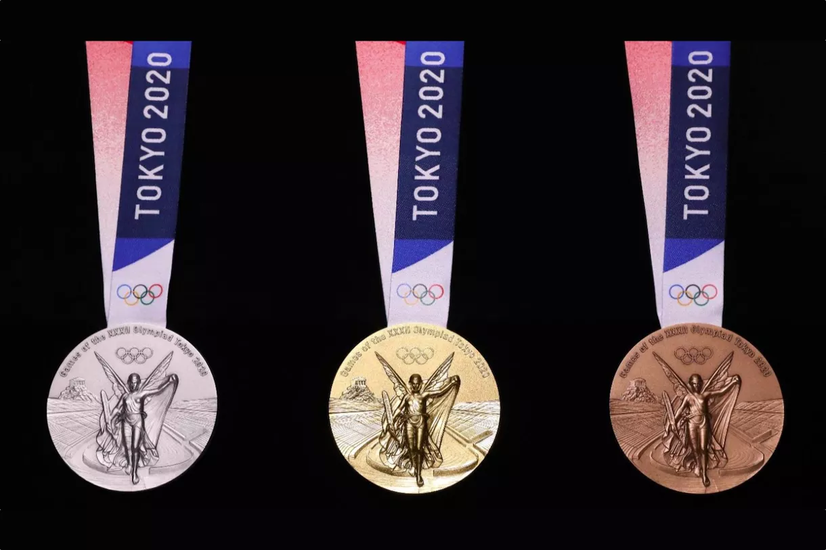
Problem Definition
Predicting the outcome whether an athlete from athletics gets a medal.
Type of problem: Binary Classification

Slide 5
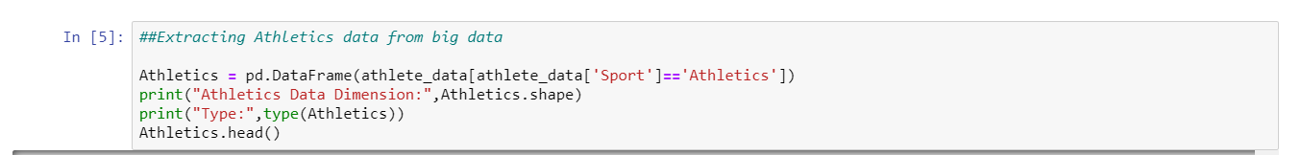
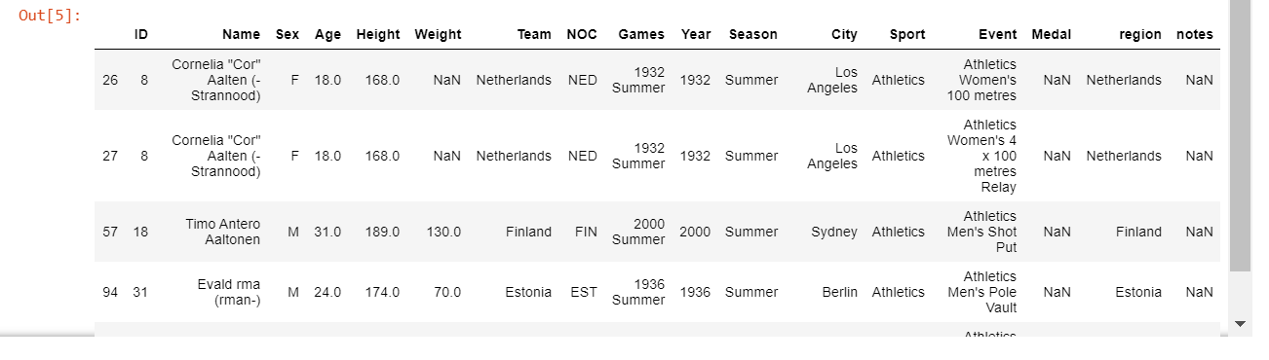
Athletics DataSet
Extracting only Athletics information from dataset.
Removing duplicates of the athletes as they may have competed in multiple Olympics for some of the analysis

Slide 6
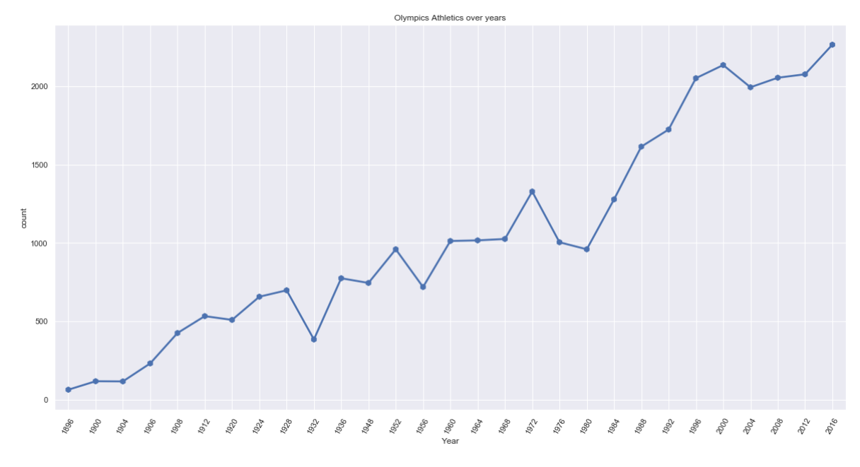
Exploratory Analysis
Visualising the number of athletes competing in Athletics event in the different years of olympics.
Comparing the number of athletes competing in Athletics event in the different years of Olympics.

Slide 7
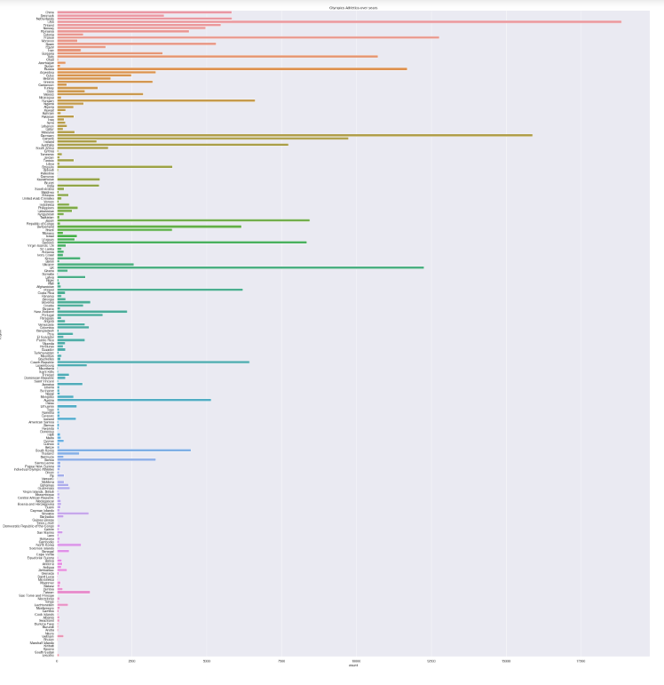
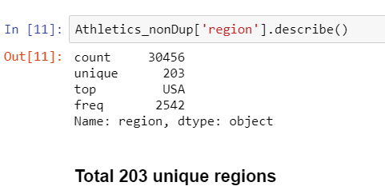
Visualising the different regions taking part in the olympics as the years progresses.

Slide 8
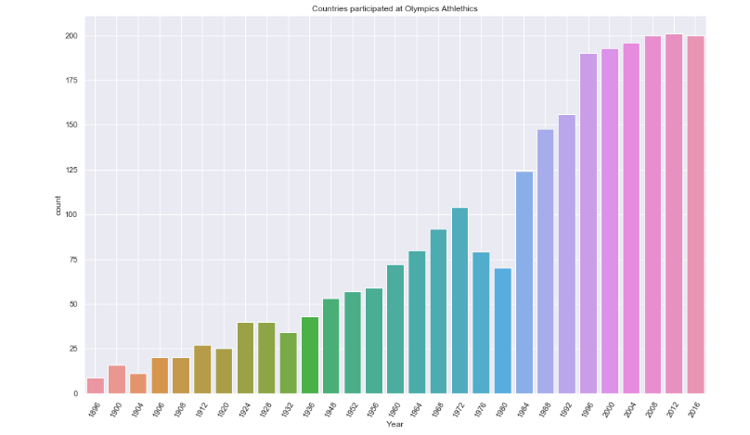
Visualising number of Number Of Countries in the different years of the olympics.
Notes:
Used Barplot

Slide 9
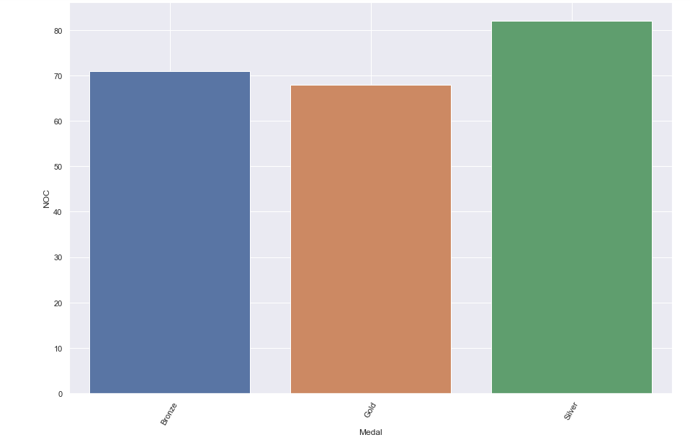
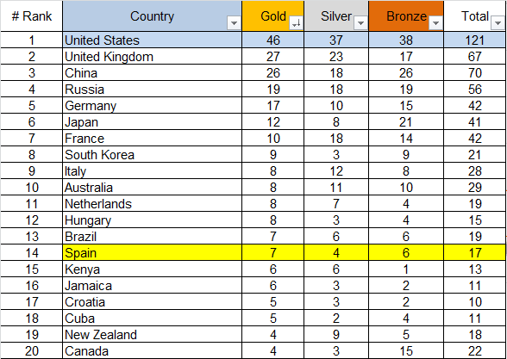
Visualising number of Medals compared to the Number Of Countries

Slide 10
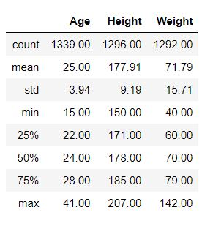
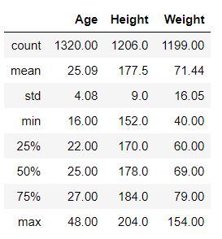
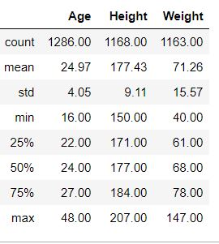
Analysing medalists
Gold Medalists
Silver Medalists
Bronze Medalists

Slide 11
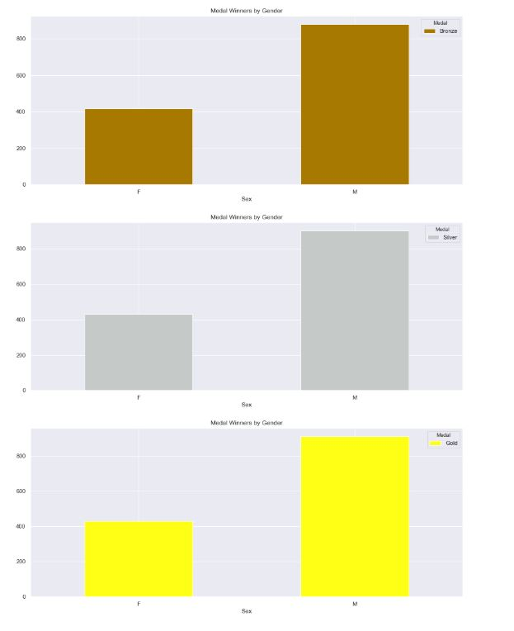
Visualising medal winners by gender
Female
Male
Female
Male
We can see that the number of female medalists for each type of medal is around half as much as the male medalists.
Female
Male

Slide 12
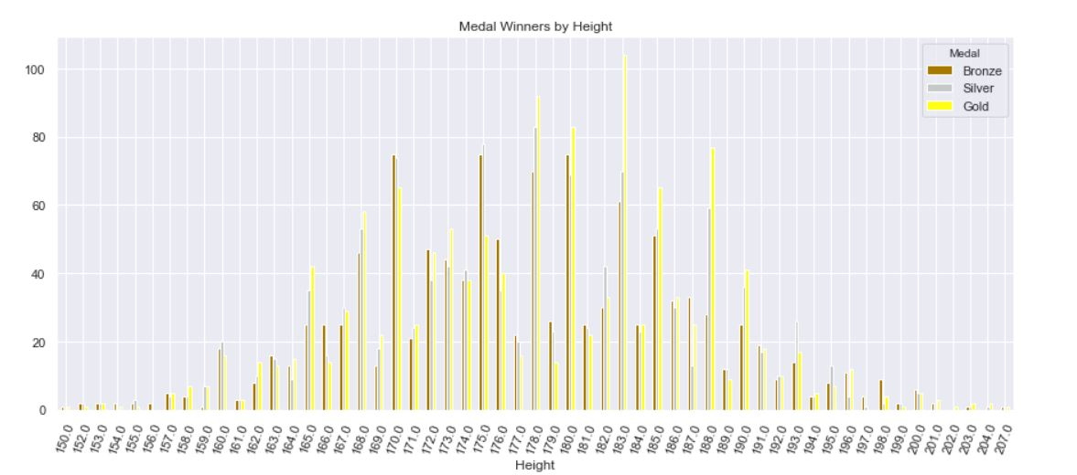
Visualizing medal winners by height
Notes:
By visualising the medal winners by height, we can see that height is not a very good indicator of whether an athlete would win a medal.

Slide 13
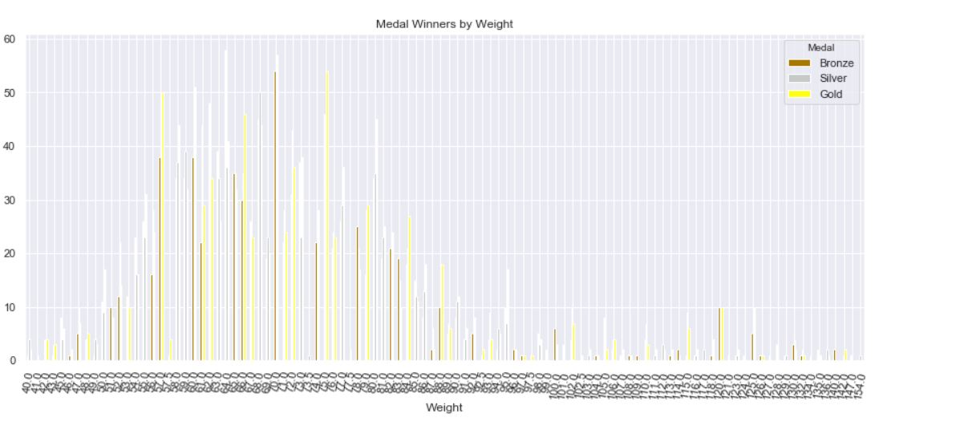
Visualizing medal winners by weight
Notes:
And by looking at the medal winners by weight, it seems that weight is a better indicator.

Slide 14
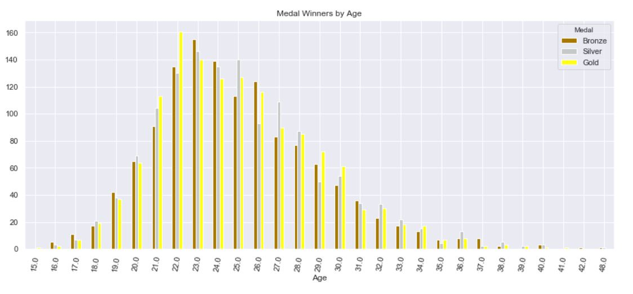
Visualizing medal winners by age
Notes:
Lastly, by visualising medal winners by age, we can see that there is quite a even distribution for all types of medal winners. Thus, out of the three factors, age is the best indicator.

Slide 15
PREPARING THE DATASET
Parameters for classification models: Age, Height, Weight, Year, Sex and Region
Some of missing data are in: Age, Height, Weight and Medal
Filling the missing data with the mean value, for medal fill with “no medal”
For classification, some parameters should be in the numeric format: Sex and Region
The predicting parameter (Medal) should be changed to only have two categories: Has Medal and No Medal.
Notes:
Sex == Gender
Region == RegionCode (using array index)

Slide 16
MACHINE LEARNING MODELS
INITIAL DECISION TREE MODEL
Split into train(80%) and test(20%) set
Predictors to use: Age, Height, Weight, Year, Sex and Region (Multi-variate)
Results (test set):
Classification accuracy: 0.8985113268
True positive rate (recall score): 0.008894536
True negative rate: 0.999423465
Notes:
Show classification report

Slide 17
MACHINE LEARNING MODELS
RESAMPLING IMBALANCED DATA
The initial model shows a major bias in predicting values as False
Ratio of False values/True values in the dataset = 8.731 -> Hugely imbalanced
Using random oversampling to balanced the dataset
Resampling for the train dataset only. The test dataset should be remain imbalanced to test our model with the true data.
Using our newly resampled train dataset to create models using other algorithms.
Notes:
Show countplot for length of data

Slide 18
 | Classification accuracy (train set) | Classification accuracy (test set) | True positive rate (test set) | True negative rate (test set)
Decision tree classifier | 0.71966 | 0.69061 | 0.73698 | 0.68536
Random forest | 0.70844 | 0.69398 | 0.64041 | 0.70438
Logistic regression | 0.62002 | 0.56854 | 0.65184 | 0.55909
MLP classifier (unstable result) | 0.64294 | 0.66809 | 0.59593 | 0.67628
Notes:
Score could slightly change due to randomly train test split

Slide 19
MACHINE LEARNING MODELS
EVENT-SPECIFIC MODELS
One more variable that was not included in the model: events.
Split the dataset into 4 datasets based on type of events: cardio, throwing, jumping and others.
Use the name of the event to choose the type of event.
For each event-specific dataset, resample the train dataset and use random forest classifier to create the model with the same predictors as previous models.
Notes:
Show unique names of events

Slide 20
 | Classification accuracy (train set) | Classification accuracy (test set) | True positive rate (test set) | True negative rate (test set)
Cardio | 0.78192 | 0.74557 | 0.66048 | 0.75486
Throwing | 0.80091 | 0.71582 | 0.56410 | 0.73768
Jumping | 0.88525 | 0.78752 | 0.58000 | 0.76373
Others | 0.85672 | 0.73878 | 0.62069 | 0.75463

Slide 21
MACHINE LEARNING MODELS
CONCLUSION
Resampling is one of the ways to solve bias in the predicting models give an imbalanced dataset. But the models created may have decreased general accuracy.
Decision tree and random forest maybe are the two better algorithms when using imbalanced dataset.
Event-specific models have better general accuracy, but suffers from overfitting due to the length of the data set is shorter.
Notes:
Show unique names of events

Slide 22
WORK ALLOCATION
Syabil Bin Kwajah: Exploratory Analysis - General analysis
Ni Jiayi: Exploratory Analysis - Medal factor
Nguyen To Vinh Huy: Data cleaning and Machine Learning Models

